Slide 1
Exersice test
Presentet by :
Mehrdad Taherioun MD

Slide 2
Purposes of Exercise Testing
Detection of coronary artery disease (CAD) in patients with chest pain (chest discomfort) syndromes or potential symptom equivalents
Evaluation of the anatomic and functional severity of CAD
Prediction of cardiovascular events and all-cause death
Evaluation of physical capacity and effort tolerance
Evaluation of exercise-related symptoms
Assessment of chronotropic competence, arrhythmias, and
response to implanted device therapy
Assessment of the response to medical interventions

Slide 3
Cardiovascular Responses to Exercise in Normal Subjects
skeletal muscle blood flow and oxygen extraction increase, the latter as much as 3-fold.
peripheral resistance decreases
while systolic blood pressure, mean arterial pressure, and pulse pressure usually increase
Diastolic blood pressure can remain unchanged or decrease to a small degree
Cardiac output can increase as much as 4- to 6-fold

Slide 4
HR Response
maximum predicted HR=220–age +/-12 beats
sufficient effort = 85% of age-predicted maximal HR
should not be used in isolation as a termination criterion
Exaggrated HR : prolonged bed rest// deconditioning // anemia // CHF
HR recovery: rapid fall during the first 30 seconds after exercise, followed by a slower return to the preexercise level.

Slide 5
Types of Exercise
Mechanical (dynamic, static)
metabolic (aerobic, anaerobic)
exercise testing manifest a predominant dynamic–aerobic component

Slide 6
Arterial Blood Pressure Response
Systolic blood pressure rises 10 mm Hg/MET
Diastolic pressure usually remains about the same or is moderately decreased
After maximum exercise, systolic blood pressure usually declines because of the rapid decrease in cardiac output, normally reaching resting levels or lower within 6 minutes,and even remaining lower than preexercise levels for several hours

Slide 7
What is a MET?
Metabolic Equivalent Term
1 MET = "Basal" aerobic oxygen consumption to stay alive = 3.5 ml O2 /Kg/min
Actually differs with thyroid status, post exercise, obesity, disease states
But by convention just divide ml O2/Kg/min by 3.5

Slide 8
Key MET Values (part 1)
1 MET = "Basal" = 3.5 ml O2 /Kg/min
2 METs = 2 mph on level
4 METs = 4 mph on level
< 5METs = Poor prognosis

Slide 9
Key MET Values (part 2)
10 METs = As good a prognosis with medical therapy
13 METs = Excellent prognosis, regardless of other exercise responses
16 METs = Aerobic master athlete

Slide 10
Calculation of METs on the Treadmill
METs = Speed x [0.1 + (Grade x 1.8)] + 3.5
3.5
Calculated automatically by Device!
    Note: Speed in meters/minute
conversion = MPH x 26.8
Grade expressed as a fraction

Slide 11
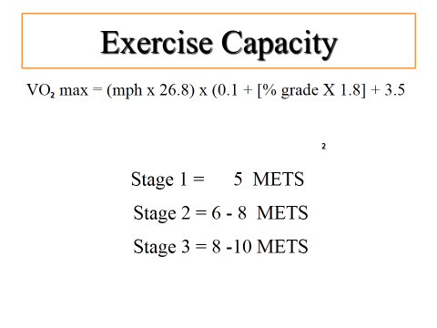

Slide 12
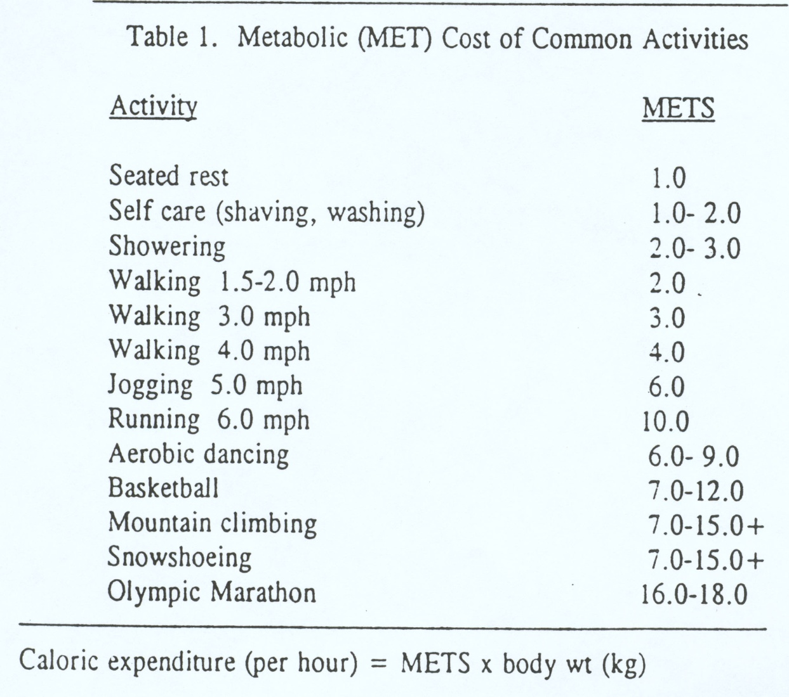

Slide 13
Absolute Contraindications
Acute myocardial infarction (MI), within 2 days
Ongoing unstable angina
Uncontrolled cardiac arrhythmia with hemodynamic compromise
Active endocarditis
Symptomatic severe aortic stenosis
Decompensated heart failure
Acute pulmonary embolism, pulmonary infarction, or deep vein thrombosis
Acute myocarditis or pericarditis
Acute aortic dissection
Physical disability that precludes safe and adequate testing

Slide 14
Relative Contraindications
Known obstructive left main coronary artery stenosis
Moderate to severe aortic stenosis with uncertain relation to symptoms
Tachyarrhythmias with uncontrolled ventricular rates
Acquired advanced or complete heart block
Hypertrophic obstructive cardiomyopathy with severe resting gradient
Recent stroke or transient ischemic attack
Mental impairment with limited ability to cooperate
Resting hypertension with systolic or diastolic blood pressures >200/110 mm Hg
Uncorrected medical conditions, such as significant anemia, important electrolyte imbalance, and hyperthyroidism

Slide 15
Subject Preparation
Clear indication
should not eat for 3 hours before
detailed explanation
β-blockers, CCB
Medication should be recorded
brief history and physical examination

Slide 16
Subject Preparation
A resting supine standard 12-lead ECG should be obtained before exercise
Torso ECG in supine and standing
torso ECG can shift the frontal plane axis to the right, increasing voltage in the inferior leads
disappearance of Q in a previous inferior MI or artifactual Q in some leads
Hyperventilation at rest could produce nonspecific ST-segment changes caused FP results and should be recorded

Slide 17
Skin Preparation
shaved and then rubbed with alcohol-saturated gauze rubbed with rough material
skin resistance can be reduced to 5000 Ω or less.

Slide 18
Electrodes and Cables
silver–silver chloride combinations with adherent gel
Wrapping the torso with a 6-inch elastic bandage or with a fitted torso net
Cables generally have a life span of about 1 year

Slide 19
Exercise Protocols
standard Bruce protocol include its use in many published studies
The Cornell protocol reduces the large workload changes between stages
The Naughton and Balke protocols also provide more modest increases in workload between stages
cycle ergometry, the initial power output is usually 10 or 25 W (150 kpm/min)
The 6-minute walk test is a functional test heart failure, chronic obstructive pulmonary disease and peripheral arterial occlusive disease )

Slide 20
Cycle Ergometer
less expensive, occupies less space, and is less noisy than a treadmill
V̇o2max is 10% to 20% lower in cycle versus treadmill testing in those not accustomed to cycling

Slide 21
Treadmill
tightly grasp the front or side= decrease workload
close their fists, and place one finger of each hand on the rails to maintain balance

Slide 23
Exercise Test Supervision
Written informed consent should be obtained written informed consent should be obtained
Supervision can be assigned to a properly trained nonphysician (ie, a nurse, physician assistant, or exercise physiologist
Doctor should be immediately available
Surveys suggest that 0 to 6 deaths or cardiac arrests per 10 000 tests and 2 to 10 MIs per 10 000 tests might be expected,

Slide 24
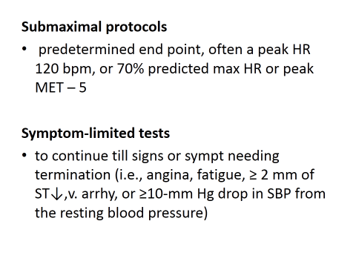
WHEN TERMINATE

Slide 25
ABSOLOUTE Indications for Termination of Exercise Testing
ST-segment elevation (>1.0 mm) in leads without preexistin Q
Drop in systolic blood pressure >10 mm Hg
Moderate-to-severe angina
ataxia, dizziness, near syncope
cyanosis or pallor
Sustained ventricular tachycardia (VT) or other arrhythmia, including second- or third-degree atrioventricular (AV) block
Technical difficulties in monitoring the ECG or systolic blood pressure
The subject’s request to stop

Slide 26
Relative Indications
ST displacement (horizontal or downsloping of >2 mmpoint [the end of the QRS
Drop in systolic blood pressure >10 mm Hg in the absence of other evidence of ischemia
Increasing chest pain
Fatigue, shortness of breath, wheezing, leg cramps, or claudication
Arrhythmias other than sustained VT, including multifocal ectopy, ventricular triplets, supraventricular tachycardia, and bradyarrhythmias that have the potential to become more complex or to interfere with hemodynamic stability
Exaggerated hypertensive response (systolic blood pressure>250 mm Hg or diastolic blood pressure >115 mm Hg)
Development of bundle-branch block that cannot immediately be distinguished from VT

Slide 27
The Postexercise Period
Cool down?
supine position
Monitoring should continue for 6 to 8 minutes after exercise

Slide 28
Exercise Capacity
Aerobic exercise capacity is one of the single best predictors of risk for future adverse events

Slide 29
The ECG During Exercise
P-wave magnitude increases
The PR segment shortens and slopes downward
Decrease QRS duration
J-Point Deviation and Upsloping ST Depression
Upsloping ST depression at peak exercise might be seen in 10% to 20% of normal subjects

Slide 30
Blood Pressure Abnormalities During Exercise and Recovery
Pathophysiological mechanisms for exercise-induced hypotension include aortic outflow obstruction, severe LV dysfunction, and myocardial ischemia
An exaggerated BP ≥210 mm Hg for men and ≥190 mm Hg for women
exercise test termination are a systolic or diastolic blood pressure of >250 and >115 mm Hg, respectively.

Slide 32
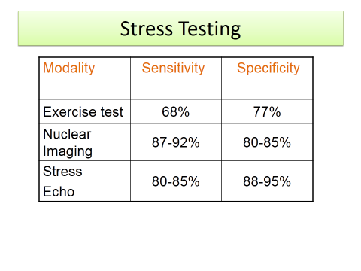

Slide 33



Thank you

